Slide 1
The importance of Key Enabling Technologies (KETs) for SMEs
SME envoys’ meeting Madrid, 6 June 2014
Pascal FAURE Director General for competitiveness, industry and services

Slide 2
SUMMARY
1
What are the KETs?
2
KETs at the heart of the competitiveness policy
3
Opportunities for SMEs
4
5
State of play on KETs and SMEs’contribution to the value chains
Obstacles to the development and industrial application of KETs

Slide 3
6
Initiatives launched by public authorities aiming at facilitating KETs development
7
Focus on French KETs strategy
8
Point of view of France on the European strategy for KETs
9
10
In a nutshell
Questions for discussion

Slide 4
1. What are the KETs?
Communication
COM (2009) 512/3
"Preparing for our future: Developing a common strategy for KETs
in the EU"
6 KETs
Nanotechnology
Micro- & Nano-electronics
Photonics
Advanced Materials
Industrial Biotechnology
Advanced Manufacturing Systems

Slide 5
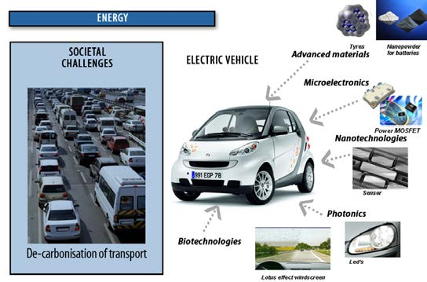
KETs are building blocks which can be combined for the manufacturing of a wide range of high value-added products and related services.
Source : final report of the HLG on KETs, June 2011

Slide 6
2. KETs at the heart of the competitiveness policy
KETs offer promising prospects : global market with high growth potential (more than 1 trillion euros expected by 2015) and response to major societal challenges (transport, energy, information society , health, etc.) .
They can play a crucial role in reversing the trend of industrial decline which has been observed in the EU these last years.
They are considered as strategic for the European industrial competitiveness (Communication COM (2012) 341 “A European strategy for Key Enabling Technologies - A bridge to growth and jobs” and European Council’s conclusions of 20-21 March, 2014).

Slide 7
3. Opportunities for SMEs
SMEs are the backbone of the European economy:
more than 99% of European businesses ;
two thirds of private sector jobs ;
more than half of the total value-added created by businesses in the EU.
They can play an important part along the KETs’ value chains (RDI, industrialization, commercialization), as drivers of innovation and job creation, if they seize opportunities in due time.

Slide 8
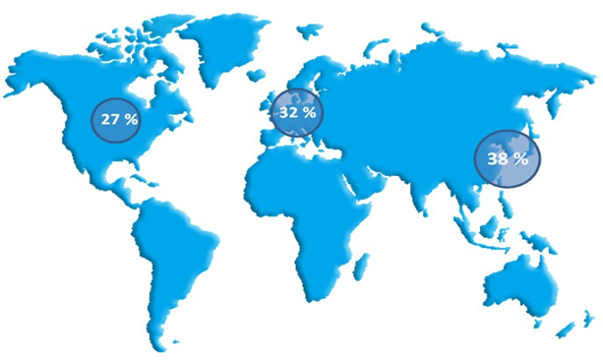
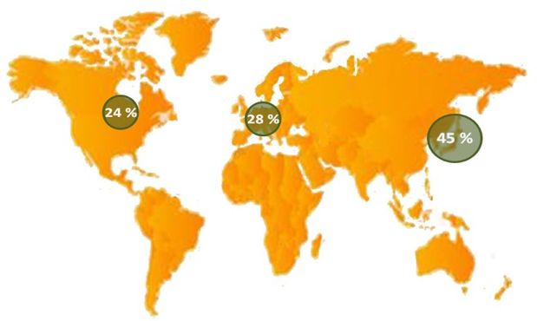
4. State of play on KETs and SMEs’contribution to the value chains
The EU is a major worldwide player for KETs but is faced with an increasing pressure from its main competitors.
2010 2012
Source : KETs observatory-PATSTAT data and report 2010, European Commission in Key Enabling Technologies (TNO/ZEW), TKM analysis, February 2013

Slide 9
The state of play of KETs deployment varies within Europe. However, there is a common concern of Member States for KETs to be structuring components of today and tomorrow industry.
SMEs’ contribution to the KETs value chains appears to be significant, even though the scarcity of available data does not allow for a comprehensive and conclusive overview on this subject .

Slide 10
5. Obstacles to the development and industrial application of KETs
Lack of appropriate research and technological development infrastructures
Shortage of skilled workers
Weak orientation of RDI policies towards innovation and commercialization stages
Lack of funding

Slide 11
Configuration of the industrial landscape at national level
Difficult access to IPR at a reasonable cost
Competition from third countries
Market size and lack of demand from the public sector

Slide 12
6. Initiatives launched by public authorities aiming at facilitating KETs development
National initiatives
National research strategies and programmes
Public procurement
Financial instruments
Clusters

Slide 13
European initiatives
EU funding instruments : Horizon 2020 & ESIF
KETs observatory
Knowledge and Innovation Community
Important Projects of Common Interest (IPCI)

Slide 14
7. Focus on French KETs strategy
Invest For the Future Programme (Programme Investissements d’Avenir)
PIA
€ 35 billion national loan and public investment aiming at strengthening productivity and innovation, increasing enterprises’competitiveness, but also promoting employment and equal opportunities by enhancing investment and innovation in five priority sectors: higher education and training; research; industrial sectors and SMEs; sustainable development; digital economy.

Slide 15
Nanobiotechnology Programme :
it intends to obtain important contributions in the field of health, through an emerging field which is nanomedicine, and in the environment field, through studies on nanoecotoxicology
Technologically Research Institutes
through strategic PPPs in research, training and innovation, they strengthen the ecosystem formed by clusters and allow France to achieve excellence in key areas for the future and develop economic sectors among the most competitive in the world.
Innovation 2030 – Worlwide innovation challenge:
it is a committee set up by the French Government which aims at identifying the key technologies which will be indispensable for the French industry in 10-15 years.

Slide 16
The 34 sector-based initiatives
French strategic review to define France’s industrial policy priorities.
34 plans
“34 industrial renewal initiatives” aiming at focusing on economic and industrial stakeholders around common goals, aligning government means more effectively to these goals, and harnessing local ecosystems to build a new and competitive French industrial offering able to win market share in France and at global level, thereby creating jobs. These initiatives are at the nexus of three broad transitions in energy and environment, digital technology, and technology and society.
Some examples of the 34 sector-based initiatives:
Embedded software and systems; Electric-propulsion satellites; Technical and smart textiles; Smart grids; Green chemicals and biofuels; Medical biotechnologies; Digital healthcare; Nano-electronics; Connected Services; Supercomputers; Robotics; Cybersecurity; Industrial plant of the future.

Slide 17
Examples of French successful strategies to develop SMEs’ access to KETs:
CAP’TRONIC programme: French strategy to develop SMEs’ access to nanoelectronics and embedded software technologies which contributes to the diffusion of these KETs into application sectors.
KETs
Nano 2017: R&D programme supported by STMicroelectronics and by LETI (CEA laboratory dedicated to nanoelectronics) combining the efforts of multiple partners, public and private, in the French Grenoble area. It aims at promoting strong collaboration between STMicroelectronics and all industrial partners of the nanoelectronics ecosystem, among them many SMEs of Electronic Design Automation (EDA) and Design.

Slide 18
8. Point of view of France on the European strategy for KETs
Orienting EU funding towards projects which lead to first exploitation and production on the European territory ;
Providing easier access of SMEs to KETs which includes reinforcement of early stage financing (venture capital) and availability of suitable technological platforms (European network to be explored further in close relation with these companies’ needs) ;
Taking into account the competitiveness of European companies vis-à-vis their competitors from third countries, in particular by making sure that R&D projects can be implemented as swiftly as possible.

Slide 19
9. In a nutshell
KETs offer real assets for the European industry that SMEs have to seize all along the value chains .
The EU remains a major worlwide player in this field even though its lead has been eroding these last years due to fierce global competition.
In order for SMEs to fully take part in the KETs-related economy, some major constraints still need to be removed, notably by facilitating access to financing and providing the right R&D infrastructures.
National and European support programmes need to complement each other to make European companies more competitive at global level.

Slide 20
10. Questions for discussion
Do you find it useful to establish a diagnosis of the SMEs’ position in the KETs value chains in order to identify more precisely their needs and direct public policies accordingly?
What are the main constraints to SMEs’ access to KETs and how could they be lifted? In particular, does the development of SMEs’ access to a European network of technological platforms seem appropriate to better integrate these companies in the KETs value chains?
What are the strategies in favour of KETs which seem to be the most promising at national level? How can the EU support them? In particular, does the exchange of good practice seem relevant in this area?
How can we achieve the competitiveness of European companies in the KETs sector vis-à-vis third countries?

Slide 21
Thank you for your attention!

