Slide 1


ONLINE-S3
ONLINE Platform for Smart Specialisation Policy Advice
H2020-ISSI-2015-1
Title of event
Location, Date
Name of presenter + organisation

Slide 2












Project consortium

Slide 3
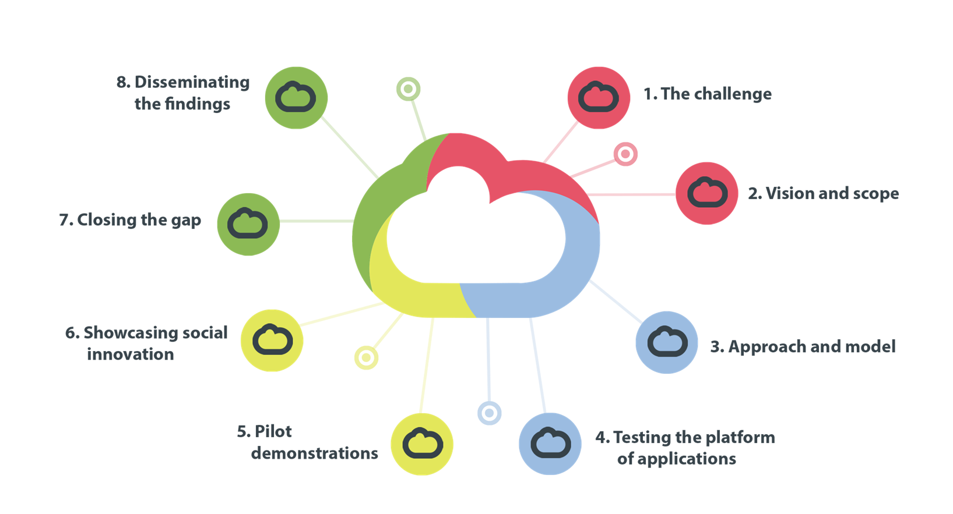
Project overview

Slide 4
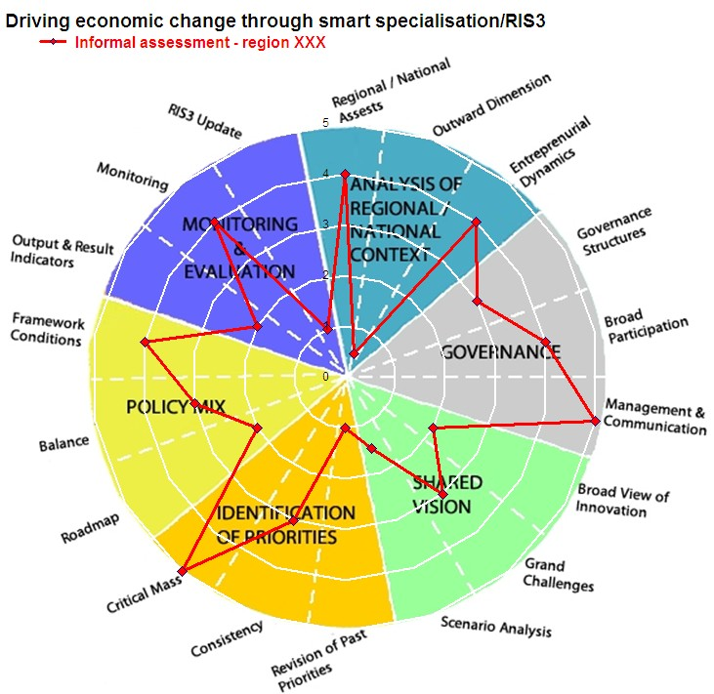
1. The challenge
In line with the ex-ante conditionality of Europe’s Structural and Investment Funds (ESIF), regions of member states must design and implement a research and innovation strategy for smart specialisation

Slide 5
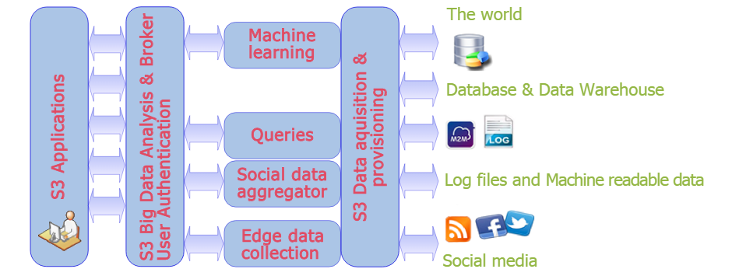
1. The challenge
In accordance with this conditionality, Online S3 shall develop an ONLINE Platform for Smart Specialisation Policy Advice
This Policy Advice shall guide member states on the design of research and innovation strategies and implementation of Smart Specialisation

Slide 6
2. Vision and scope
This vision of S3 as an ONLINE Platform for Smart Specialisation Policy Advice, shall scope the opportunities digital technologies offer to:
leverage the data available to underpin the design of research and innovation strategies
support the implementation of smart specialisation
assemble guidance on the design of Research and Innovation Strategies and as to the implementation of Smart Specialisation (RIS3)

Slide 7
3. Approach and model
Founded on a Science 2.0 approach to research and innovation strategies
Built as a Quadruple Helix model of co-evolutionary systems
The ONLINE Platform for Smart Specialisation Policy Advice shall develop by way of consultations and deliberations

Slide 8
4. Testing the platform of applications
Testing the cloud-based computing and social media-enabled technologies of this ONLINE Platform will proceed by way of web content mining and through natural language processing.
These shall crowdsource the knowledge-based services, which not only underpin this process of entrepreneurial discovery, but that also support Smart Specialisation as Policy Advice on the open innovation of user-centric applications.

Slide 9
5. Pilot demonstrations
Pilot demonstrations shall also underpin in-situ assessments of S3 as an ONLINE platform.
4 pilot demonstrations
These evaluations shall source the collective intelligence needed for such computing technologies to design knowledge-based services as tools to implement Smart Specialisation

Slide 10
6. Showcasing social innovation
These evaluations shall showcase the social innovation of user-centric applications as the enterprise of stakeholder communities, whose ONLINE Platform sources the collective intelligence of crowds and which co-design knowledge-based services as tools that implement Smart Specialisation.
Tools that implement Smart Specialisation as Policy Advice on the creation of wealth across member states and which assemble guidance on the capacity of RIS3 to sustain an inclusive growth of Europe’s regions.

Slide 11
7. Closing the gap
Present regional policy as a social innovation in user-centric applications
Innovations that underpin this process of entrepreneurial discovery and whose co-design of knowledge-based services, work to support the implementation of smart specialisation by closing the gap between the advice which is available for nation states to create wealth and Europe’s regions to assemble guidance on the capacity of RIS3 to sustain an inclusive growth.

Slide 12
8. Disseminating the findings
Online S3 shall provide a platform to disseminate the project’s findings on the entrepreneurial discovery of this territorial governance model, including the publication of 17 open access publications over the duration of the project

Slide 13
Allocation of tasks
7 work packages:
  WP1. RIS3 strategies: State of play and emerging trends
  WP2. Online S3 mechanism for RIS3 policy advice
  WP3. Online S3 platform creation
  WP4. Tools, apps and e-services
  WP5. Pilot experimentation of the platform, apps and e-services
  WP6. Project dissemination, scalability and sustinability
  WP7. Project management and co-ordination

Slide 14
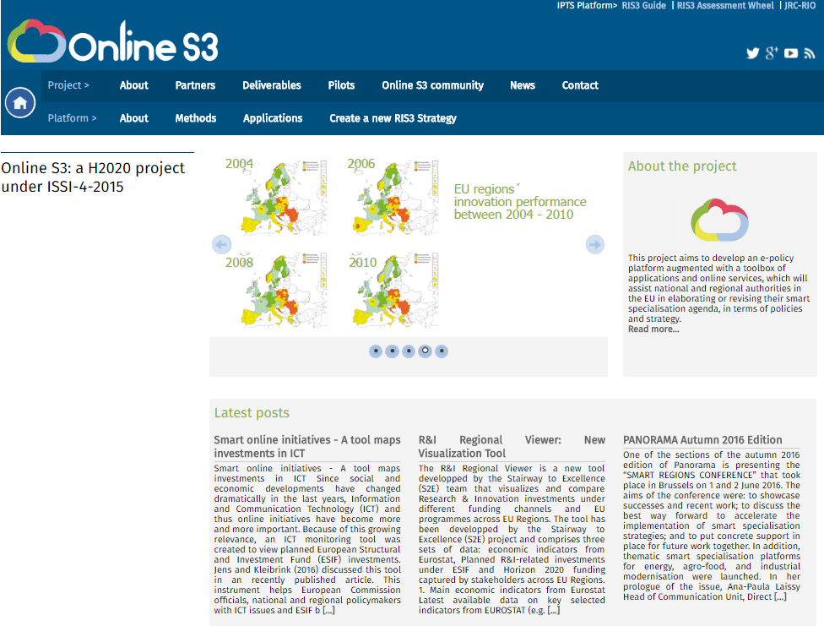
http://www.onlines3.eu/

Slide 15
Thank you.
Contacts:
Project Director: Ms. Eva Garcia Muntion (evagarcia@rtdi.eu)
Chief Methodology Officer: Prof. Nicos Komninos (komninos@urenio.org)
Chief Impact Officer: Prof. Mark Deakin (m.deakin@napier.ac.uk)

